Slide 1
Lecture 1: Introduction to Embedded System Verification CS/ECE584
September 4th 2012
Sayan Mitra

Slide 2
Plan for today
Administrivia
Project
Background concepts
OR A Brief History of Mechaned Reasoning

Slide 3
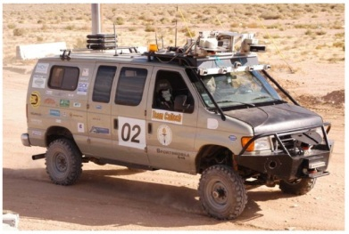
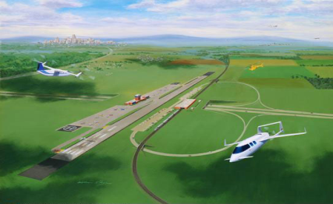
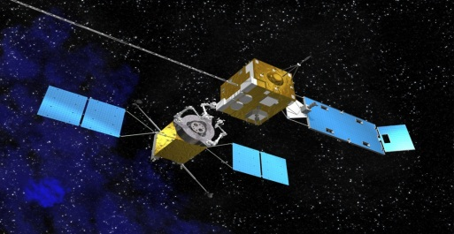
Motivation for Embedded System Verification
Examples of “Embedded” or “Cyber-Physical” Systems
Characteristics
A control system
implemented in software
with many sensors, signal & data processing algorithms
communications over networks
Image courtesy NASA
Image courtesy NASA
dynamics
state machines
quantization
message drops

Slide 4
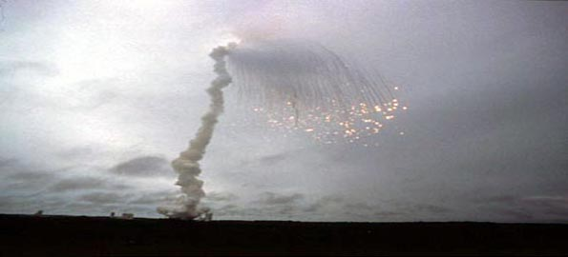
Motivation for Embedded System Verification
Unlike “one-shot” function computations, computations of embedded systems are infinite streams
Example: Rudder positions computed by an autopilot program: L, R, R, R, C, L, …
Testing and simulations (at least their naïve applications) can check for only finitely many behaviors
Not sufficient for covering all behaviors of Embedded Systems
Is this a real problem?
Yes!
“June 4, 1996 -- Ariane 5 Flight 501. Working code for the Ariane 4 rocket is reused in the Ariane 5, but the Ariane 5's faster engines trigger a bug in an arithmetic routine inside the rocket's flight computer. The error is in the code that converts a 64-bit floating-point number to a 16-bit signed integer. The faster engines cause the 64-bit numbers to be larger in the Ariane 5 than in the Ariane 4, triggering an overflow condition that results in the flight computer crashing.” --- History's Worst Software Bugs, Simson Garfinkel, Wired 2005

Slide 5
Motivation for Embedded System Verification
CalTech’s autonomous vehicle ALICE disqualified in the 3rd round of the DARPA Urban challenge after an unforeseen interaction between the path planner and the obstacle-avoidance algorithm caused ALICE to crash through the road barriers
More Epic Fails in Embedded Systems:
Mariner I space probe crash, Chinook helicopter crashed (1994, killed all 29 passengers), Swedish JAS 39 Gripen fighter crash (1993), Mars climate orbiter crash ($125 M, 1999), Patriot missile time to float conversion error (28 soldiers), …
More general systems: Pentium Div ($475 M), Knight Capital Group’s algorithmic trading software caused massive volume buys and sells ($440 M),

Slide 6
Motivation for Embedded System Verification
The promise of Automatic Verification
An algorithm takes as input
(a) the description of system A and
(b) property P
and terminates with output
(c) a proof that all the behaviors of A satisfy P OR
(d) a particular behavior of A that violates P
Examples:
A: model of autonomous vehicle P: always stays on the road
A: model of a traffic control system P: vehicles do not collide
A
A satisfies P
Verification Algorithm
P
Trace of A violating P

Slide 7
Guarded Optimism
Hardware verification (model checking) is now part of engineering practice in the industry
Synchronous languages like Esterel and Lustre and their analysis suites are well-adopted in avionics and process control industries
Success stories from Software Verification: SLAM tool from MSR
Commercial and non-profit verification enterprises
Big EDA: Synopsis, Mentor Graphics, Cadence
Jasper, Coverity, Galois, SRI, etc.
Explosive growth in academic research
International conferences: HSCC, EMSoft, ICCPS, CAV, TACAS…
Plenty of room for research and entrepreneurship

Slide 8
Learning Objectives
Techniques and formalisms for modeling systems with dynamics, computation, and communication
Hybrid Automata
To use verification tools (model checkers, SMT solvers, and theorem provers)
Exposure to some of the best ideas in CS, current research directions & trends
Positive side-effects: connection to synthesis

Slide 9
Administrivia & Course Overview
Tools: PVS, PHAVer, SpaceEx, UPPAAL
Download and install
Start looking at the tutorials and examples
Webpage:http://engr-courses.engr.illinois.edu/ece584/index.shtml
Mailing list: illinois-ece584@googlegroups.com
No Exams!
Homework (~40%): 3-5 sets with theoretical and programming problems
Project (~60%): Project ideas have been announced
Class participation (10%): Discussion, refine slides & notes

Slide 10
Background
Brief History of Mechanized Reasoning

Slide 11
Gottfried Liebniz (1646-1716) proposed the development of a “formal system” that would reduce proving validity of statements to calculations
Settle all controversy on any subject whatsoever could be settled by “taking their pens in their hands and calculating”
Reasoning without worrying about the veracity of individual propositions or statements

Slide 12
Digging deeper into Proofs
What is a Proof?
A proof is sufficient evidence for the truth of a proposition.
Real world and science: Evidence is drawn from nature and experiments
Law: Evidence comes from witnesses and forensics; “principle of beyond sufficient doubt”
A mathematical proof of a proposition is sequence of unambiguous statements that demonstrate its validity assuming some axioms
Notes:
Scientifically proven: is a misnomer
Legal: Beyond reasonable doubt

Slide 13
Example: Euclid’s Geometry
Axioms
A straight line segment can be drawn joining any two points.
Any straight line segment can be extended indefinitely in a straight line.
Given any straight line segment, a circle can be drawn having the segment as radius and one endpoint as center.
All right angles are congruent.
Given any straight line and a point not on it, there "exists one and only one straight line which passes" through that point and never intersects the first line, no matter how far they are extended.
Theorems: Statements about objects in plane geometr
Sum of angles of a triangle equals 180 degrees
Pythagoras’ Theorem
…

Slide 14
Propositional Logic
Syntax (rules for constructing well formed sentences)
Countable set of (atomic) propositions PS: P1, P2, P3, …
S = $True \left| False \right|p_{1}\left| ¬p_{1}\right|{ p}_{1}⋀p_{2} \left| p_{1}\bigvee{p_{2}}\right|p_{1}⇒p_{2}|p_{1}≡p_{2}$| (S), where $p_{1}$, p₂ are variables of type
Example: PS = A, B, C then the following are well-formed propositional statements
A, (A $∧$ B), (A $∧$ B) $⇒$ (C $∨$ A), True $⇒$ A, …

Slide 15
Semantics of Propositional Logic
Let PROPS be the set of all possible propositional logic statements
Semantics defines a truth value functions or valuations v that maps each proposition PS to a truth value (T or F), v: PS→ {T, F} and by extension a valuation v’:PROPS→{T,F}
The valuation of a statement is inductively defined by the valuation of the propositions and the truth table of the operators
Example (cont.): if v(A) = T, v(B) = T, v(C)= F then A, v’(A $∧$ B) = T, v’((A $∧$ B) $⇒$ (C $∨$ A)) = T, v’(True $⇒$ A) = T, …
$$p_{1}$$ | $$p_{2}$$ | $${¬p}_{2}$$ | $${ p}_{1}⋀p_{2}$$ | $$p_{1}⇒p_{2}$$ | $$p_{1}≡p_{2}$$
F | F | T | F | T | T
F | T | F | F | T | F
T | F | T | F | F | F
T | T | F | T | T | T

Slide 16
Satisfiability, Validity, and Tautologies
A proposition A is valid v’(A) = T for all valuations v. A is also called a tautology
Example: A $⇒$ A, A $∨¬ A$, (A $⇒$ B) $≡$ ($¬ B⇒¬$A)
A proposition is satisfiable if there is a valuation (or truth assignment) v such that v(A) = T.
Example (P $∨$ Q) /\ ($¬$P $∨$ $¬$Q) is satisfied by the valuation v(P) = F and v(Q) = T
A proposition is unsatisfiable if it is not satisfied by any valuation
(P $∨$ Q) /\ ($¬$P $∨$ $¬$Q) /\ P is unsatisfiable
Lemma. A proposition A is a valid if and only if $¬$A is unsatisfiable.
Checking (un)satisfiability is called boolean satisfiability problem (SAT).
How to check that a given proposition is valid / satisfiable?
Truth table method (check all possible 2^{n} valuations)
Decision Procedure: An algorithm for solving a decision problem (e.g. SAT, Validity)
Unfortunately, the above exponential search is also the best we can do, in theory. SAT is NP-complete
Though modern SAT solvers routinely handle propositions with millions of atomic propositions and constraints

Slide 17
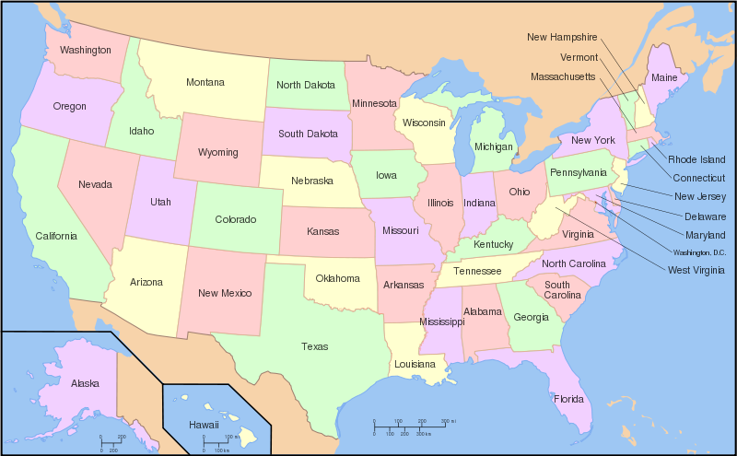
Four colors suffice
Any 2D map can be colored with 4 colors
Any planar graph can be colored with 4 colors!
This is the (famous) 4 color theorem proposed in 1852 when Francis Guthrie (to De Morgan), while trying to color the map of counties of England
Kenneth Appel and Wolfgang Haken (1976, at UIUC) proved the four color theorem to much acclaim!
Proof reduced infinite set of possible maps to 1,936 reducible configurations which had to be checked one by one by computer and took > 1000 hours

Slide 18
Revisiting Definition of a Proof
A mathematical proof of a proposition is sequence of unambiguous statements that demonstrate (to whom?) its validity assuming some axioms
Human mathematicians?
Computers?
Proof of the 4-color theorem

Slide 19
Graph/Map Coloring with SAT
For each of the k vertices create 2 binary variables
a₀₀ = T iff vertex a is RED
a₀₁ = T iff vertex a is BLUE
a₁₀ = T iff vertex a is YELLOW
a₁₁ = T iff vertex a is GREEN
Encode the graph constraints
a₀₀ $⇒$ $(¬$ a_{01 /\} $¬$ a_{10 /\} $¬$ a_{11 /\} ) /\ …
$(¬$ (a₀₀$≡$b₀₀) \/ $¬$ (a₀₁$≡$b₀₁) \/ $¬$ (a₁₀$≡$b₁₀) \/ $¬$ (a₁₁$≡$b₁₁)) /\ …
See this page http://www.cs.cmu.edu/~bryant/boolean/macgregor.html
a
g
b
c
f
d
e

Slide 20
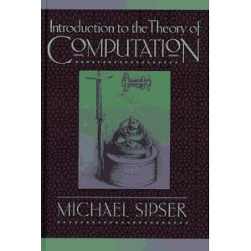
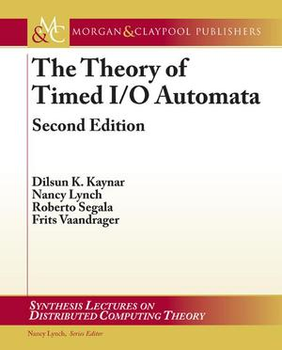
Reading Assignments
Further reading: any standard textbook on theory of computation, e.g., Introduction to Theory of Computation by Michael Sipser
Turing Machines
Decidability
Complexity classes P, NP, NP-hard, NP-complete
Next: Predicate Logic, and
Timed Automata

