Slide 1
ECE/CS 584: Verification of Embedded Computing Systems
Lecture 02
Sayan Mitra

Slide 2
Propositional Logic Summary
Syntax (rules for constructing well formed sentences)
Countable set of (atomic) propositions PS: P1, P2, P3, …
S = $True | p_{1}\left| ¬S_{1}\right|{ S}_{1}⋀{ S}_{2}$| (S₁)
Semantics defines a truth value functions or valuations v that maps each proposition PS to a truth value (T or F), v: PS→ {T, F} and by extension a valuation v’:PROPS→{T,F}
A proposition A is valid v’(A) = T for all valuations v. A is also called a tautology
A proposition is satisfiable if there is a valuation (or truth assignment) v such that v(A) = T.
Checking (un)satisfiability is called boolean satisfiability problem (SAT).
SAT is (decidable) NP-complete problem

Slide 3
Predicate Logic or First Order Logic
Syntax defined by a signature of predicate & function symbols
Variables
Predicate symbols with some valence or arity
a is predicate of 0-arity, like propositions
P(x) is a predicate of 1-arity
Q(x,y) is a predicate of 2-arity
Function symbols of some valence,
Function symbols of 0 arity are called constants
f(x) is a function of arity 1, e.g., -x
A term t ::= x | f(t1,t2,t3,…), where t1, t2, t3, … are terms
A formula $φ$::= a | P(x) | Q(x,y) | t1 = t2 |$¬φ$ | ($φ$1 $⇒φ$2) | … | … | $∀xφ$ | $∃xφ$
Example of Well Formed Formula
$∃x P\left(x\right),\text{∀}\text{x}\text{∀}\text{y}\text{(}\text{E}\text{(}\text{x}\text{, }\text{y}\text{) ⇒ }\text{E}\text{(}\text{y}\text{, }\text{x}\text{))}$, $∀x y Q\left(x,f\left(y\right)\right) ≡Q(f(y),x)$
Bounded and unbounded variables, closed formulas
Notes:
Can encode, real arithmetic with addition Prsberger, graph theory, groups, abstract algebras.

Slide 4
Semantics
An interpretation or a model M of a FOL formula assigns meaning to all the non-logical symbols and a domain for the variables (i.e., the variables, the predicate symbols, and the function symbols)
D: Domain of discourse
For each variable x, a valuation v(x) gives a value in D
Each function symbol f of arity n is assigned a function D^{n} → D
Each predicate symbol P of atity n is assigned a predicate D^{n} → {T, F}
If formula $φ$ evaluates to T with model M, then we say M satisfies $φ$, M $⊨φ$and$φ$ is said to be satisfiable
$φ$ is valid if it is true for every interpretation

Slide 5
Example (Un)Decidable Classes
Prefix | # of n-ary predicate symbols | # of n-ary function symbols | With Equality | Name
∀∃∀ | ω, 1 | 0 | N | Kahr 1962
∀³∃ | ω, 1 | 0 | N | Suranyi 1959
∀*∃ | 0,1 | 0 | N | Kalmar-Suranyi 1950
∀∃∀∃* | 0,1 | 0 | N | Gurevich 1966
∀ | 0 | 2 | Y | Gurevich 1976
∀ | 0 | 0, 1 | Y | Gurevich 1976
∀²∃ | ω, 1 | 0 | Y | Goldfarb 1984
∃*∀* | all | 0 | Y | Ramsey 1930
∃*∀∃* | all | all | N | Maslov-Orevkov 1972
∃* | all | all | Y | Gurevich 1976
all | ω | ω | N | Lob 1967
Undecidable
Decidable

Slide 6
Presberger Arithmetic [1929]
First order theory of natural numbers with addition (no multiplication)
Signature: Two constants 0 and 1, and a binary function +
Axioms:
~(0 = x + 1)
x + 1 = y + 1 $⟹$ x = y
x + 0 = x
(x + y) + 1 = x + (y + 1)
(Infinity Axiom) For any first order formula P(x), P(0) $∧$ ($∀x P\left(x\right)⇒P(x+1)) ⟹ ∀y P\left(y\right)$
Example: $∀x ∃ y (\left(y+y=x\right) ∨(y+y+1=x)$
Cannot formalize divisibility or prime numbers
Consistent: For any A, if A can be deduced from the axioms then ~A cannot be
Complete: For any A, either A can be deduced or ~A can be deduced
Decidable: There is an algorithm which decides for any A, whether A is true or ~A is true
Complexity $O(2^{2^{cn}})$, n : length of the formula c is some consant [Fischer & Rabin 1974]
1954 Martin Davis implemented Presberger’s decision procedure on “Johnniac” at IAS

Slide 7
Theory of Time Input/Output Automata
Lecture 02
Sayan Mitra

Slide 8
Roadmap
Syntax
Semantics
Abstraction, Implementation
Simulations
Composition
Substitutivity

Slide 9
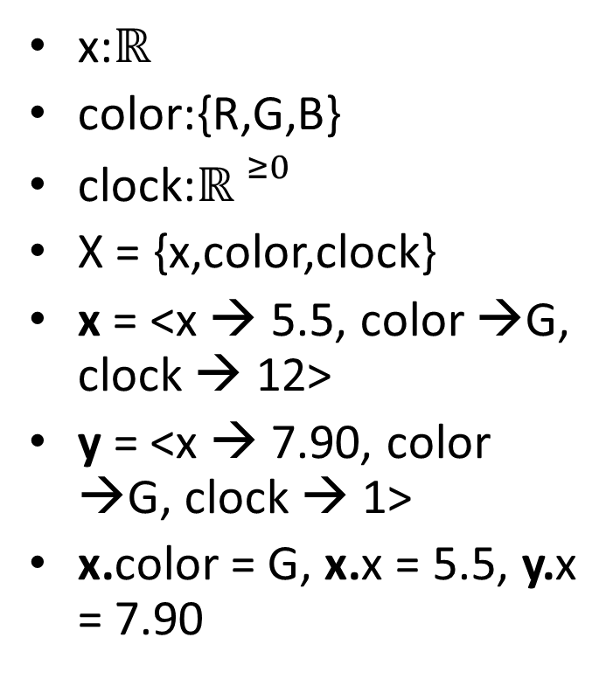
Variables and Valuations
A variable x is a name for a state component
type(x)
A set of variables X
A valuation for X maps each x $∈X$ to an element in type(x)
$val(X)$: set of all valuations of X
x:$ℝ$
color:{R,G,B}
clock:${ℝ }^{≥0}$
X = {x,color,clock}
x = <x → 5.5, color →G, clock → 12>
y = <x → 7.90, color →G, clock → 1>
x.color = G, x.x = 5.5, y.x = 7.90

Slide 10
Trajectories
Time = ${ℝ }^{≥0}$
Time interval = [a,b]
A trajectory for X is a function $τ:\left[0,t\right]→val\left(X\right),$ where [0,t] is an interval
$τ.dom=[0,t]$
x is continuous (or analog) if all its trajectories are piecewise continuous
Discrete if they are piecewise constant
Notations: $τ$.fstate, $τ$.lstate, $τ$.x, $τ$.X
Prefix, suffix, concatenation

Slide 11
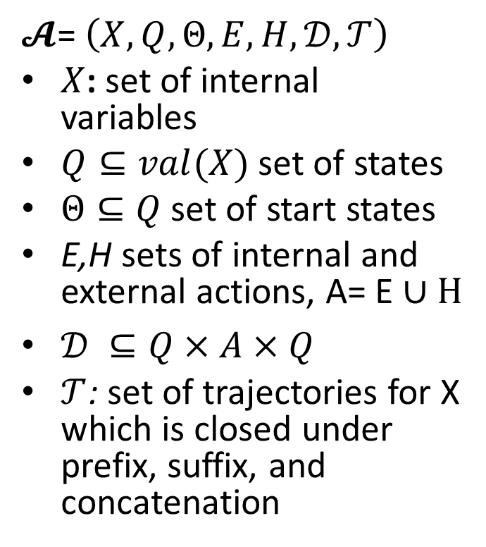
Hybrid Automata (a.k.a Timed Automata Kaynar, et al. 2005)
$𝓐$= $\left(X,Q,Θ,E,H,𝒟,𝒯\right)$
$X$: set of internal variables
$Q⊆val(X)$ set of states
$Θ⊆Q$ set of start states
E,H sets of internal and external actions, A= E ∪ H
$𝒟 ⊆Q×A×Q$
$𝒯$: set of trajectories for X which is closed under prefix, suffix, and concatenation
Notes:
Pick a couple of nice examples

Slide 12
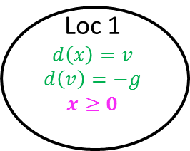
Bouncing Ball
bounce
x = 0 /\ v < 0
v’ := -cv
Automaton Bouncingball(c,h,g)
variables: analog x: Reals := h, v: Reals := 0
states: True
actions: external bounce
transitions:
bounce
pre x = 0 /\ v < 0
eff v := -cv
trajectories:
evolve d(x) = v; d(v) = -g
invariant $x≥0$
Loc 1
$$d\left(x\right)=v$$
$$d\left(v\right)=−g$$
$$x≥0$$
x:= h
Graphical Representation used in many articles
TIOA Specification Language
(close to PHAVer & UPPAAL’s language)

Slide 13
Trajectory Semantics

