Slide 1
ECE/CS 584: Hybrid Automaton Modeling Framework Invariance, Abstractions, Simulation
Lecture 04
Sayan Mitra

Slide 2
Plan for Today
Invariants (continued)
Abstraction
Simulation relations

Slide 3
Inductive Invariants
Given a hybrid automaton $𝓐$= $\left(X,Q,Θ,E,H,𝒟,𝒯\right)$
An S $⊆Q$ is an invariant if ${Reach}_{𝓐}$ $⊆$ S
An invariant S is inductive if for any v ∈ S
If v—a→ v’ then v’ ∈ S
If v—τ→ v’ then v’ ∈ S
Theorem: For any set of states S if
for any v ∈ $Θ$ start state, v ∈ S
If v ∈ S and v—a→ v’ then v’ ∈ S
If v ∈ S and v—τ→ v’ then v’ ∈ S
Then Reach$𝒜⊆S$
Proof rule for establishing an inductive invariant S
Checking an inductive invariant is relatively simple
Finding useful invariants is in general more involved

Slide 4
Invariants and Inductive Invariants
All invariants inductive? No
Examples: x≤ h (not inductive)
x≤ h /\ v² = 2g(h-x)

Slide 5
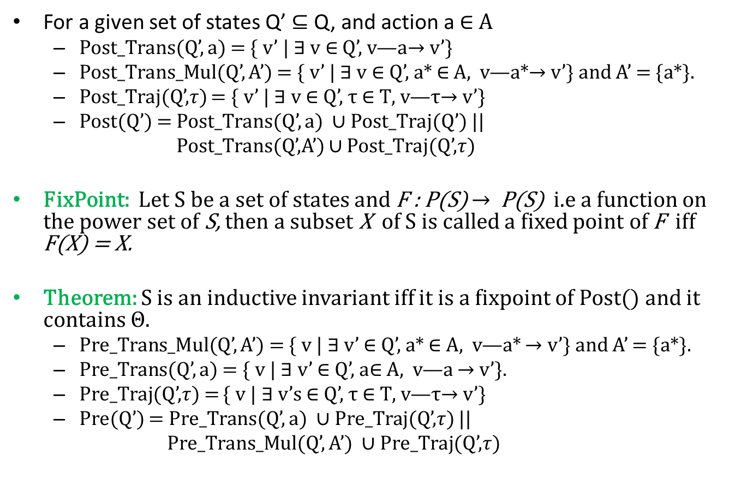
Pre and Post Computations
For a given set of states Q’ $⊆$ Q, and action a $∈$ A
Post_Trans(Q’, a) = { v’ | ∃ v ∈ Q’, v—a$→$ v’}
Post_Trans_Mul(Q’, A’) = { v’ | $∃$ v ∈ Q’, a* ∈ A, v—a*$→$ v’} and A’ = {a*}.
Post_Traj(Q’,$τ$) = { v’ | ∃ v ∈ Q’, τ ∈ $Τ$, v—τ$→$ v’}
Post(Q’) = Post_Trans(Q’, a) ∪ Post_Traj(Q’) ||
Post_Trans(Q’,A’) ∪ Post_Traj(Q’,$τ)$
FixPoint: Let S be a set of states and F : P(S) $→$P(S) i.e a function on the power set of S, then a subset X of S is called a fixed point of F iff F(X) = X.
Theorem: S is an inductive invariant iff it is a fixpoint of Post() and it contains $Θ.$
Pre_Trans_Mul(Q’, A’) = { v | ∃ v’ ∈ Q’, a* ∈ A, v—a* $→$ v’} and A’ = {a*}.
Pre_Trans(Q’, a) = { v | ∃ v’ ∈ Q’, a∈ A, v—a $→$ v’}.
Pre_Traj(Q’,$τ$) = { v | ∃ v’s ∈ Q’, τ ∈ $Τ$, v—τ$→$ v’}
Pre(Q’) = Pre_Trans(Q’, a) ∪ Pre_Traj(Q’,$τ$) ||
Pre_Trans_Mul(Q’, A’) ∪ Pre_Traj(Q’,$τ$)

Slide 6
Abstractions
Invariants overapproximate the set of reachable states
E.g. “height is always less than h”
Abstractions overapproximate executions
E.g. “there is a bounce every c^{n} seconds”
Pablo Picasso, Portrait of Gertrude Stein, 1906, MOMA, New York. When someone commented that Stein didn't look like her portrait, Picasso replied, "She will". From Wikipedia.

Slide 7
Abstraction and Implementation ($≤$)
$𝒜$₁ and $𝒜$₂ are comparable if they have the same external interface, i.e., E₁ = E₂
For two comparable automata, $𝒜$₁ implements $𝒜$₂ if Traces₁ $⊆$ Traces₂
$𝒜$₂ is an abstraction of $𝒜1$ if Execs₁ $⊆$ Execs₂
$𝒜$₁ is a refinement of $𝒜2$

Slide 8
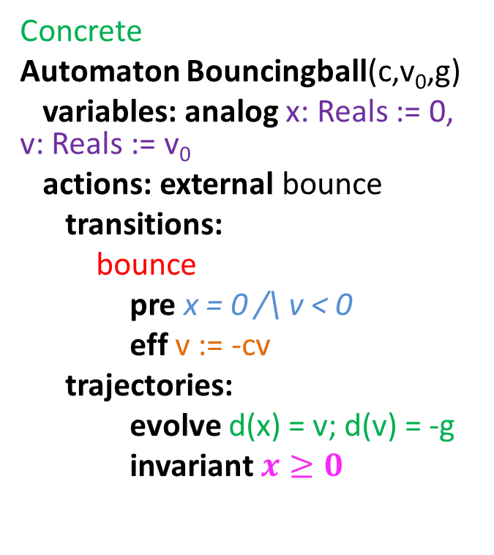
Abstract Bounce
Concrete
Automaton Bouncingball(c,v₀,g)
variables: analog x: Reals := 0, v: Reals := v₀
actions: external bounce
transitions:
bounce
pre x = 0 /\ v < 0
eff v := -cv
trajectories:
evolve d(x) = v; d(v) = -g
invariant $x≥0$
Abstract
Automaton BounceAbs(c,h,g)
variables: analog
timer: Reals := $\sqrt{2gh}$,
n:Naturals=0;
actions: external bounce
transitions:
bounce
pre timer = 0
eff n:=n+1; timer := ${\sqrt{2gh}}/{c^{n}}$
trajectories:
evolve d(timer) = -1
invariant timer $≥0$

Slide 9
Simulations
Forward simulation relation from $𝒜$₁ to $𝒜$₂ is a relation R $⊆ Q_{1}× Q_{2}$ such that
For every x₁ ∈ $Θ1$ there exists x₂ ∈ $Θ2$ such that x₁ R x₂
For every x₁ –a₁ $→$ x₁’ ∈ $𝒟$ and x₂ ∈ $Q2$ such that x₁ R x_{2,} there exists x₂’ such that
x₂ –$β→$ x₂’ and
x₁’ R x₂’
Trace($β$) = Trace(a₁)
For every $τ$ ∈ $𝒯$ and x₂ ∈ $Q2$ such that x₁ R x_{2,} there exists x₂’ such that
x₂ –$β→$ x₂’ and
x₁’ R x₂’
Trace($β$) = Trace($τ)$
Theorem. If there exists a forward simulation relation from $𝒜$₁ to $𝒜2$ then Traces₁ $⊆$ Traces₂

Slide 10
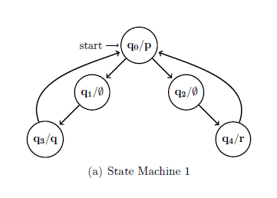
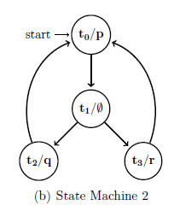
State Machine 2 Implements State Machine 1

Slide 11
Forward Simulation for Abstraction
Forward simulation relation from $𝒜$₁ to $𝒜$₂ is a relation R $⊆ Q_{1}× Q_{2}$ such that
For every x₁ ∈ $Θ1$ there exists x₂ ∈ $Θ2$ such that x₁ R x₂
For every x₁ –a₁ $→$ x₁’ ∈ $𝒟$ and x₂ ∈ $Q2$ such that x₁ R x_{2,} there exists x₂’ such that
x₂ –$β$ $→$x₂’ and
x₁’ R x₂’
For every $τ$ ∈ $𝒯$ and x₂ ∈ $Q2$ such that x₁ R x_{2,} there exists x₂’ such that
x₂ –$τ$ $→$x₂’ and
x₁’ R x₂’
Theorem. If there exists a forward simulation relation from $𝒜$₁ to $𝒜2$ then Execs₁ $⊆$ Execs₂

Slide 12
Characteristics of Hybrid Automata
Guards, Transition relations, Invariants, DAEs written in some language
These objects define the Transitions and Trajectories
Transitions and trajectories define executions and traces
Decidability of verification problem will depend on the choice of the language
Nondeterministic
Transition choice
Transition relation
Branching trajectories
External interface
External actions
Further partitioned into I/O actions
External variables available in the hybrid I/O automaton model
Special cases
Deterministic HA
Rectangular HA
(Alur-Dill) Timed Automata
X = Finitely many variables with finite types → Finite State Machine with Labeled transitions
X = n real valued variables {x1, …, xn} and A = {} D = {} → Dynamical System

