Slide 1
ECE/CS 584: Hybrid Automaton Modeling Framework Simulations and Composition
Lecture 05
Sayan Mitra

Slide 2
Plan for Today
Abstraction and Implementation relations (continued)
Composition
Substitutivity
Looking ahead
Tools: PVS, SpaceEx, Z3, UPPAAL
Decidable classes
Invariant generation
CEGAR
…

Slide 3
Some nice properties of Forward Simulation
Let $𝒜, ℬ, and 𝒞$ be comparable TAs. If R₁ is a forward simulation from $𝒜$ to $ℬ$ and R₂ is a forward simulation from $ℬ$ to $𝒞$, then R₁ $∘$ R₂ is a forward simulation from $𝒜$ to $𝒞$
$𝒜$ implements $𝒞$
The implementation relation is a preorder of the set of all (comparable) hybrid automata
(A preorder is a reflexive and transitive relation)
If R is a forward simulation from $𝒜$ to $ℬ$ and R⁻¹ is a forward simulation from $ℬ$ to $𝒜$ then R is called a bisimulation and $ℬ$ are $𝒜$ bisimilar
Bisimilarity is an equivalence relation
(reflexive, transitive, and symmetric)
Notes:
Relational composition

Slide 4
A Simulation Example
$$ℬ$$
$𝒜$ is an implementation of $ℬ$
Is there a forward simulation from $𝒜$ to $ℬ$ ?
Consider the forward simulation relation
$𝒜 :$ 2—c→4 cannot be simulated by $ℬ$ from 2’ although (2,2’) are related.
a
3
2’
b
1
a
c
2
4
$$𝒜$$
3
b
a
1
2
c
4

Slide 5
Backward Simulations
Backward simulation relation from $𝒜$₁ to $𝒜$₂ is a relation R $⊆ Q_{1}× Q_{2}$ such that
If x₁ ∈ $Θ1$ and x₁ R x₂ then x₂ ∈ $Θ2$ such that
If x’₁ R x’₂ and x₂—a→ x₂’ then
x₂ –$β$→ x₂’ and
x₁ R x₂
Trace($β$) = a₁
For every $τ$ ∈ $𝒯$ and x₂ ∈ $Q2$ such that x₁’ R x₂’, there exists x₂ such that
x₂ –$β$→ x₂’ and
x₁ R x₂
Trace($β$) = $τ$
Theorem. If there exists a backward simulation relation from $𝒜$₁ to $𝒜2$ then ClosedTraces₁ $⊆$ ClosedTraces₂

Slide 6
Composition of Hybrid Automata
The parallel composition operation on automata enable us to construct larger and more complex models from simpler automata modules
$𝒜$₁ to $𝒜$₂ are compatible if X₁ ∩ X₂ = H₁ ∩ A₂ = H₂ ∩ A₁ = ∅
Variable names are disjoint; Action names of one are disjoint with the internal action names of the other

Slide 7
Composition
For compatible $𝒜$₁ and $𝒜$₂ their composition $𝒜$₁ || $𝒜$₂ is the structure $𝓐$= $\left(X,Q,Θ,E,H,𝒟,𝒯\right)$
$X=X1 ∪X2$ (disjoint union)
$Q⊆val(X)$
$Θ=\left\{ x∈Q\right| ∀ i ∈\left\{1,2\right\}: x.Xi∈Θi\}$
H = H₁ ∪ H₂ (disjoint union)
E = E₁ ∪ E₂ and A= E ∪ H
$\left(x,a,x\right)∈ 𝒟$ iff
$a$ $∈H1$ and $(x.X1,a,x′.X1$) $∈ 𝒟$₁ and $x.X2=x.X2$
$a$ $∈H2$ and $(x.X2,a,x′.X2$) $∈ 𝒟$₂ and $x.X1=x.X1$
Else, $(x.X1,a,x′.X1$) $∈ 𝒟$₁ and $(x.X2,a,x′.X2$) $∈ 𝒟$₂
$𝒯$: set of trajectories for X
𝜏 $∈ 𝒯$ iff $∀ i ∈\left\{1,2\right\}$, 𝜏.Xi $∈𝒯$_{i}
Theorem . $𝓐$ is also a hybrid automaton.

Slide 8
Example: Send || TimedChannel
Automaton Channel(b,M)
variables: queue: Queue[M,Reals] := {}
clock1: Reals := 0
actions: external send(m:M), receive(m:M)
transitions:
send(m)
pre true
eff queue := append(<m, clock1+b>, queue)
receive(m)
pre head(queue)[1] = m
eff queue := queue.tail
trajectories:
evolve d(clock1) = 1
stop when ∃ m, d, <m,d> ∈ queue
/\ clock=d
Automaton PeriodicSend(u, M)
variables: analog clock: Reals := 0
states: True
actions: external send(m:M)
transitions:
send(m)
pre clock = u
eff clock := 0
trajectories:
evolve d(clock) = 1
stop when clock=u

Slide 9
Composed Automaton
Automaton SC(b,u)
variables: queue: Queue[M,Reals] := {}
clock_s, clock_c: Reals := 0
actions: external send(m:M), receive(m:M)
transitions:
send(m)
pre clock_s = u
eff queue := append(<m, clock_c+b>, queue); clock_s := 0
receive(m)
pre head(queue)[1] = m
eff queue := queue.tail
trajectories:
evolve d(clock_c) = 1; d(clock_s) = 1
stop when
(∃ m, d, <m,d> ∈ queue /\ clock_c=d)
\/ (clock_s=u)

Slide 10
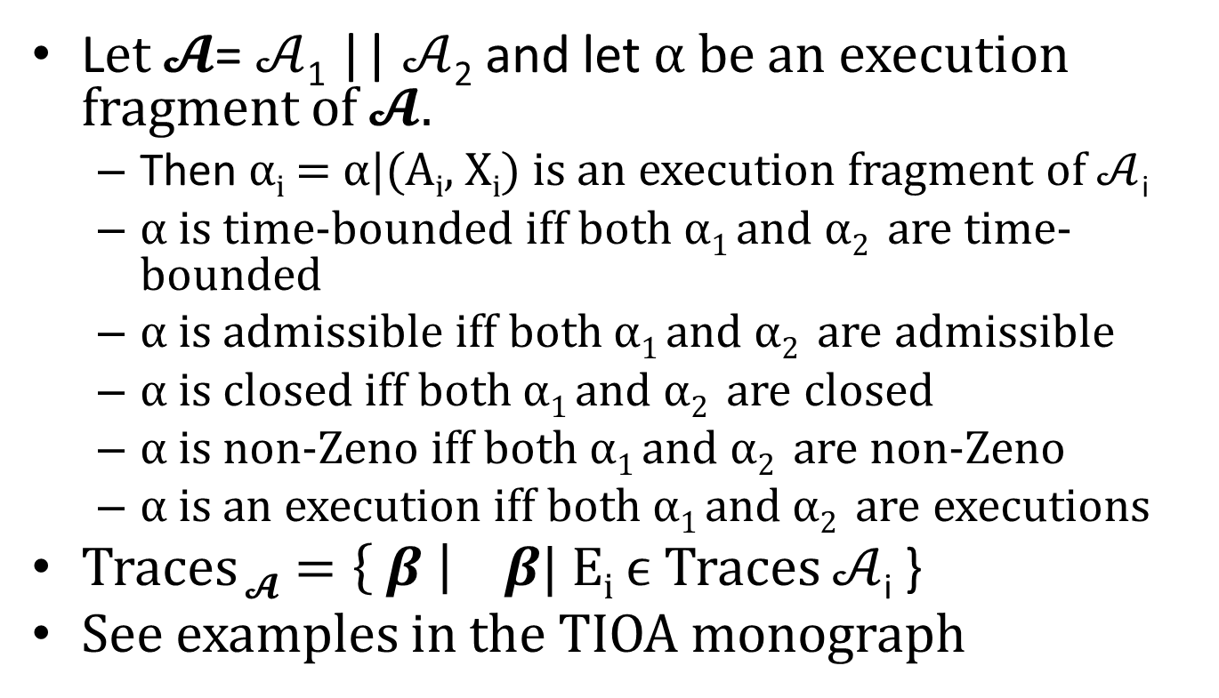
Some properties about composed automata
L$et 𝓐$= $𝒜$₁ || $𝒜$₂ and let α be an execution fragment of $𝓐.$
Then α_{i} = α|(A_{i}, X_{i}) is an execution fragment of $𝒜$_{i}
α is time-bounded iff both α₁ and α₂ are time-bounded
α is admissible iff both α₁ and α₂ are admissible
α is closed iff both α₁ and α₂ are closed
α is non-Zeno iff both α₁ and α₂ are non-Zeno
α is an execution iff both α₁ and α₂ are executions
Traces $𝓐=\left\{ β \right|$ $β$| E_{i} ϵ Traces $𝒜$_{i} }
See examples in the TIOA monograph

Slide 11
Substitutivity
Theorem. Suppose $𝒜$₁ , $𝒜$₂ and $ℬ$ have the same external interface and $𝒜$₁ , $𝒜$₂ are compatible with $ℬ$. If $𝒜$₁ implemens $𝒜$₂ then $𝒜$₁|| $ℬ$ implements $𝒜$₂ || $ℬ$
Proof sketch.
Define the simulation relation:

Slide 12
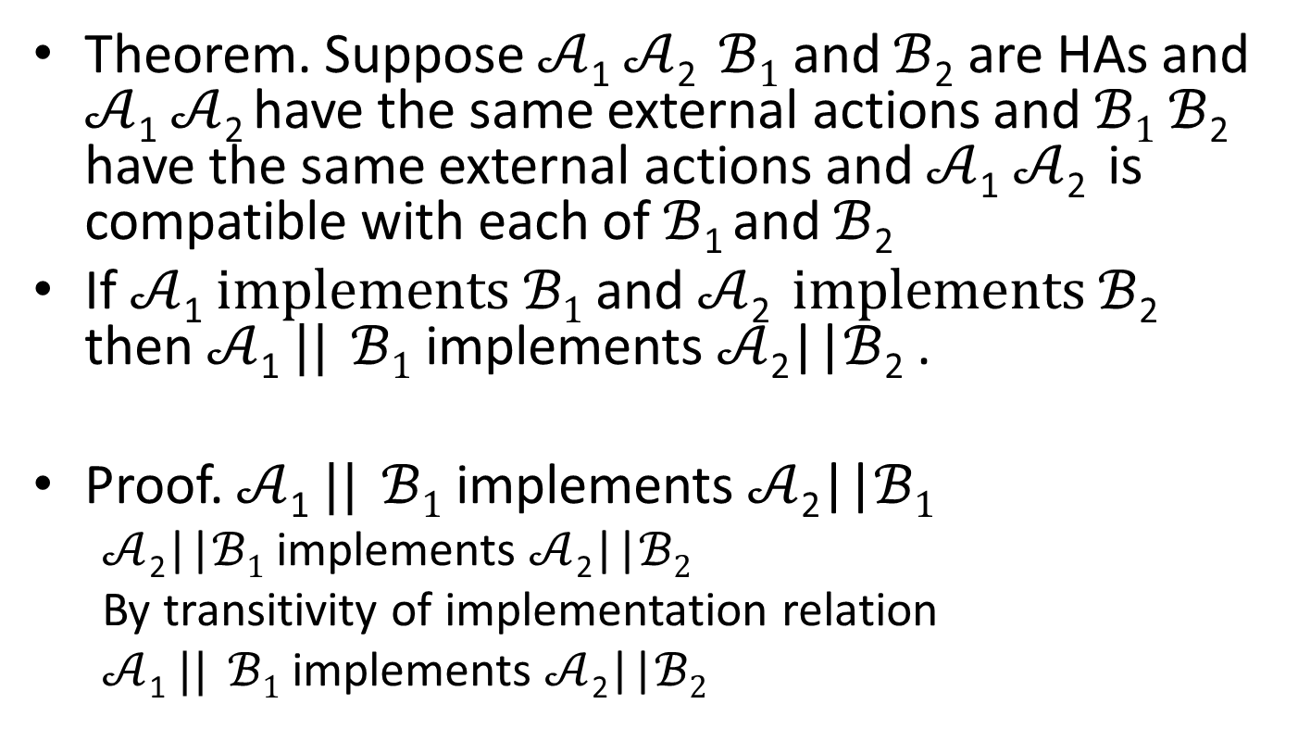
Substutivity
Theorem. Suppose $𝒜$₁ $𝒜$₂ $ℬ1$ and $ℬ$₂ are HAs and $𝒜$₁ $𝒜$₂ have the same external actions and $ℬ1$ $ℬ$₂ have the same external actions and $𝒜$₁ $𝒜$₂ is compatible with each of$ℬ$₁ and $ℬ$₂
If $𝒜$₁ $implements ℬ1$ and $𝒜$₂ $implements ℬ$₂ then $𝒜$₁ $||$ $ℬ1$ implements$𝒜$₂||$ℬ$₂ .
Proof. $𝒜$₁ $||$ $ℬ1$ implements $𝒜$₂||$ℬ1$
$𝒜$₂||$ℬ1$ implements $𝒜$₂||$ℬ2$
By transitivity of implementation relation
$𝒜$₁ $||$ $ℬ1$ implements $𝒜$₂||$ℬ2$

Slide 13
Theorem. $𝒜$₁ $||$ $ℬ2$ implements$𝒜$₂||$ℬ$₂ and $ℬ1$ implements $ℬ2$ then $𝒜$₁ $||$ $ℬ1$ implements$𝒜$₂||$ℬ$₂.

Slide 14
Summary
Implementation Relation
Forward and Backward simulations
Composition
Substitutivity

Slide 15
Example

