Slide 1
ECE/CS 584: PVS Tutorial Part 1
Lecture 05
Sayan Mitra

Slide 2
Plan for Today
Substitutivity final comments
PVS tutorial Part 1

Slide 3
Recap
Composition $𝒜$₁ || $𝒜$₂
α execution fragment of $𝓐$iff α_{i} = α$⌈$(A_{i}, X_{i}) is an execution fragment of $𝒜$_{i}
Traces $𝓐=\left\{ β \right|$ $β⌈$ E_{i} ϵ Traces $𝒜$_{i} }
Theorem 1. If $𝒜$₁ $≤𝒜_{2}$and $ℬ1≤$ $ℬ$₂
then $𝒜$₁ $||$ $ℬ1≤ 𝒜$₂||$ℬ$₂ .
Theorem 2. If $𝒜$₁ $||$ $ℬ2≤$ $𝒜$₂||$ℬ$₂ and $ℬ1≤$ $ℬ2$
then $𝒜$₁ $||$ $ℬ1≤$ $𝒜$₂||$ℬ$₂.
Conjecture. If $𝒜$₁ $||$ $ℬ2≤$ $𝒜$₂||$ℬ$₂ & $𝒜2$ $||$ $ℬ1≤$ $𝒜$₂||$ℬ$₂
then $𝒜$₁ $||$ $ℬ1≤$ $𝒜$₂||$ℬ$₂ ?

Slide 4
Fun with compositions
4 automata, all have the same external actions a, b

Slide 5
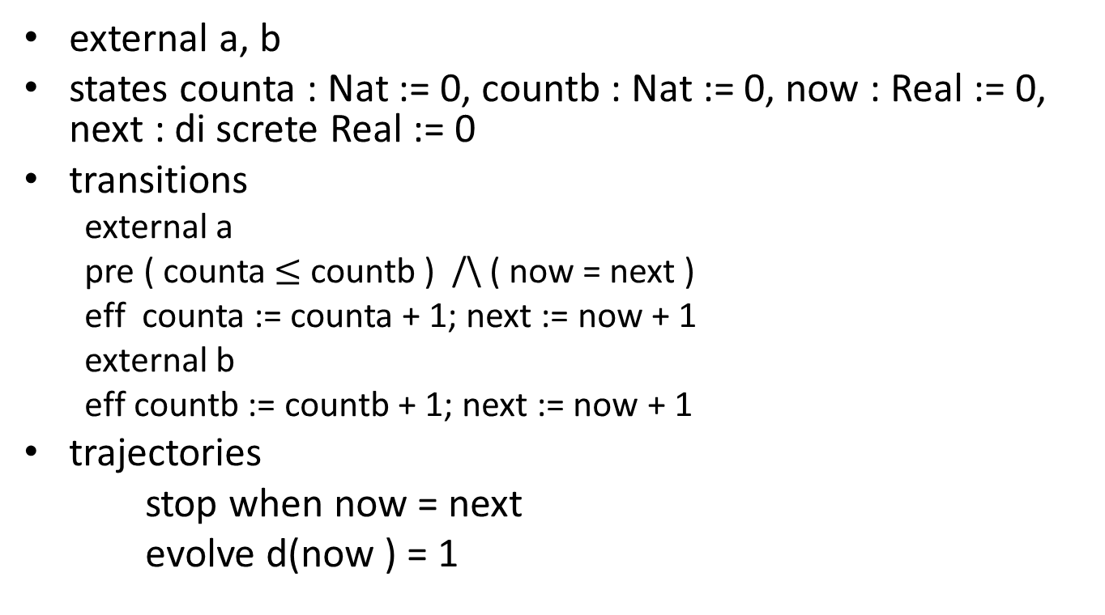
automaton CatchUpA
external a, b
states counta : Nat := 0, countb : Nat := 0, now : Real := 0, next : di screte Real := 0
transitions
external a
pre ( counta $≤$ countb ) /\ ( now = next )
eff counta := counta + 1; next := now + 1
external b
eff countb := countb + 1; next := now + 1
trajectories
stop when now = next
evolve d(now ) = 1

Slide 6
automaton CatchUpB
external a, b
states counta : Nat := 0, countb : Nat := 0, now : Real := 0, next : di screte Real := 0
transitions
external b
pre ( countb + 1 $≤$ counta ) /\ ( now = next )
eff countb := countb + 1; next := now + 1
external a
eff counta := counta + 1; next := now + 1
trajectories
stop when now = next
evolve d(now ) = 1

Slide 7
CatchUpA can perform arbitrarily many b’s and an a if counta $≤$countb
CatchUpB can perform arbitrarily many a’s and a b if counta $<$countb
CatchUpA || CatchUpB can perform arbitrarily many a’s and b’s

Slide 8
automaton BoundedAlternateA
external a, b
states myturn : Bool := true, maxout : Nat
transitions
external b
eff myturn := true
external a
pre myturn /\ ( maxout > 0)
eff myturn := false ; maxout := maxout - 1

Slide 9
automaton BoundedAlternateB
external a, b
states myturn : Bool := false, maxout : Nat
transitions
external a
eff myturn := true
external b
pre myturn /\ ( maxout > 0)
eff myturn := false ; maxout := maxout - 1

Slide 10
Putting it all together
For a given value of maxout BoundedAlternateA performs a finite number of a’s and arbitrarily many b’s
CatchUpA || BoundedAlternateB performs a finite number of alternating A’s and B’s
BoundedAlternateA || BoundedAlternateB performs a finite number of alternating A’s and B’s
CatchUpA||BoundedAlternateB $≤$ BoundedAlternateA ||BoundedAlternateB
CatchUpB||BoundedAlternateA $≤$ BoundedAlternateB ||BoundedAlternateA
But
CatchUpA || CatchUpB $≰$ BoundedAlternateA ||BoundedAlternateB

Slide 11
Wrap-up for Hybrid Automaton Modeling Framework
Nondeterministic state machines
Abstract transitions and trajectories
Synchronization through shared actions
Shared variables (used Hybrid I/O automata)
Executions, Reachability, Traces
Forward backward simulations
Substitutivity

