Slide 1
Fast and Guaranteed Safe Controller Synthesis for Nonlinear Vehicle Models
Chuchu Fan | Kristina Miller | Sayan Mitra
Department of Computing and Mathematical Engineering Caltech | Department of Electrical and Computer Engineering University of Illinois | Department of Electrical and Computer Engineering University of Illinois
July 22, 2020
32nd International Conference on Computer-Aided Verification

Slide 2
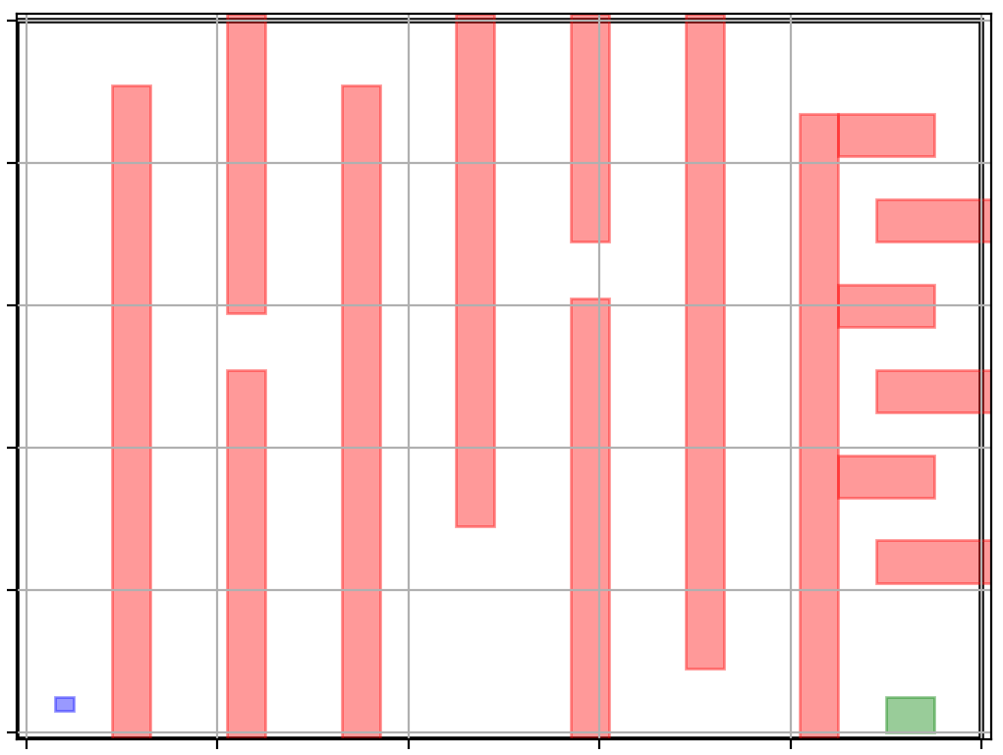
Controller synthesis problem
System Model: Nonlinear dynamical system
$$x\left[t+1\right]=f(x\left[t\right], u\left[t\right])$$
Unsafe set $O$
$$\dot{x}=f(x, u)$$
Start set $S$
Goal set $G$
Notes:
Say that start set is just an abstraction of the uncertainties in the initial configuration. There are other uncertainties in the parameters, perturbations, etc and our framework can handle it.

Slide 3
Controller synthesis problem
Notes:
Say that start set is just an abstraction of the uncertainties in the initial configuration. There are other uncertainties in the parameters, perturbations, etc and our framework can handle it.

Slide 4
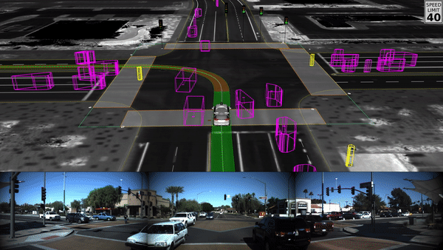
Waymo

Slide 5
Related solutions
Model Predictive Control
Implicit MPC [Mayne 14], explicit MPC [Bemporad 02], [Vitus 08], LP [Bemporad 02], QP [Ardakani 15], [Richter 11] , MILP [Vitus 08], [Raman 14], nonlinear problems [Mendes 17], [Liu 17]
Discrete Abstractions
CoSyMa [Mouelhi], Pessoa [Roy 11], LTLMop [Wong 13], Tulip [Wongpiromsarn 11], SCOTS [Rungger 16]
Safe Motion Planning
FaSTrack [Herbert 17], RTD [Vaskov 19], LQR-Trees [Tedrake 09], Funnel Libraries [Majumdar 17]
Sampling Based Planning
PRM [Kavraki 96], RRT [Kuffner 00], FMT [Janson 15]
MoveIT [Chitta 12], OMPL [Sucan 12]
In this work, we show how to combine SAT solvers and control theory to perform effective safe controller synthesis for continuous nonlinear systems with soundness guarantees.

Slide 6
Key contribution
We show in this work that nonlinear control synthesis can also be solved as a SAT problem over QF-LRA, with some help from control theory
Reference path synthesis
Tracking controller
$$ℓ_{i}$$
$$ℓ_{i−1}$$

Slide 7
Key contribution
Reference path synthesis
Nonlinear vehicle models normally can follow linear paths. We choose piecewise linear (PWL) reference paths as we will see
It can be synthesized as a SAT problem over QF-LRA
We can pre-compute the tracking error for PWL reference paths

Slide 8
Key contribution
Nonlinear vehicle models cannot follow (PWL) reference paths exactly due to
inertia
actuation limits
uncertainties
Control theory helps bound tracking error between actual trajectory and the reference
Tracking controller
$$ℓ_{i}$$
$$ℓ_{i−1}$$

Slide 9
Key contribution
Reference path synthesis
Tracking controller
Putting it all together
$$ℓ_{i}$$
$$ℓ_{i−1}$$

Slide 10
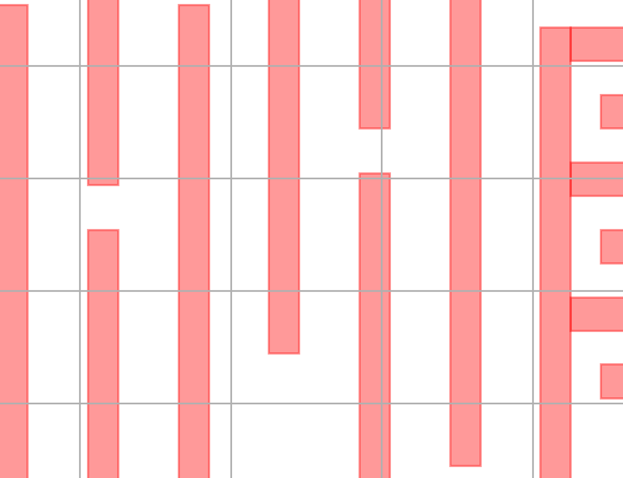
Piecewise linear reference trajectory
$$ℓ_{2}$$
$$ℓ_{3}$$
$$ℓ_{1}$$
$$ℓ_{k}$$
Each piece of the piecewise linear reference path has an error bound, which can be concatenated to get the piecewise bloated set that contains the reach sets at any time
Let say $ℓ_{i}$ is the radius of the $i^{th}$ bloated set

Slide 11
Find waypoints defining reference path away from obstacles
$$p_{k}$$
$$p_{i−1}$$
obstacle $O$
$$p_{i}$$
$$≥ℓ_{i}$$
$$p_{0}$$
$$\left\{y |Hy≤b\right\}$$
polytope
Line segment between $p_{i−1}$ and $p_{i}$ is at least $ℓ_{i}$ away from $O$
If both $p_{i−1}$ and $p_{i}$ are both outside the polytope, and both the distance $p_{i−1}$ and $p_{i}$to at least one surface of the polytope $≥ℓ_{i}$

Slide 12
Find waypoints defining reference path away from obstacles
$$p_{k}$$
$$p_{i−1}$$
obstacle $O$
$$p_{i}$$
$$≥ℓ_{i}$$
$$p_{0}$$
$$\left\{y |Hy≤b\right\}$$
polytope
The sufficient condition for the line segment $\left(p_{i−1}, p_{i}\right)$ to be at least $ℓ_{i}$ away from $O$
$$\bigvee_{j=1}^{\#surfaces}{\frac{H_{j}p_{i−1}−b_{j}}{{\left\|H_{j}\right\|}_{2}}>ℓ_{i}∧}\frac{H_{j}p_{i}−b_{j}}{{\left\|H_{j}\right\|}_{2}}>ℓ_{i}$$

Slide 13
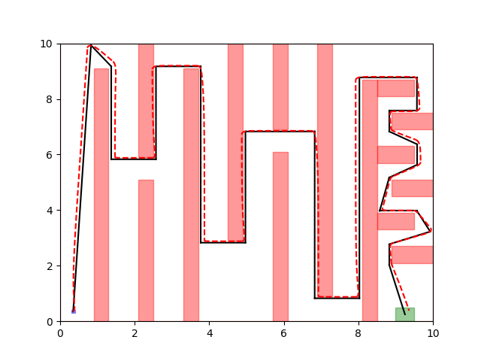
Together: synthesize $\left(p_{o}, ⋯,p_{k}\right)$ through satisfiability over QF-LRA
$∃p_{0},⋯,p_{k},$ such that
$$p_{0} =x_{ref}(0),$$
$$\bigwedge_{i}{\bigwedge_{o}{\bigvee_{j}{\frac{H_{j}p_{i−1}−b_{j}}{{\left\|H_{j}\right\|}_{2}}>ℓ_{i}∧\frac{H_{j}p_{i}−b_{j}}{{\left\|H_{j}\right\|}_{2}}>ℓ_{i}}}},$$
$$\bigvee_{G}{\bigwedge_{j}{\frac{H_{j}p_{k}−b_{j}}{{\left\|H_{j}\right\|}_{2}}<ℓ_{k}}}$$
# linear constraints grows linearly as # surfaces of $O$ and $G$ grows

Slide 14
Key contribution
Reference path synthesis
Tracking controller
Putting it all together
$$ℓ_{i}$$
$$ℓ_{i−1}$$

Slide 15
Bounding tracking error for given tracking controller
We want to design a tracking controller such that the actual trajectory is contained within $ℓ_{i}$ of the reference trajectory
Tracking error: $e\left(x\left(t\right), x_{ref}\left(t\right)\right)$ with dynamics $\dot{e}=f_{e}(e, u)$
How to find bounds on the tracking error?
Use Lyapunov functions of the error dynamics
Key challenge: compute tracking errors even when waypoints change
$$x(t)$$
$$ℓ_{i}$$
$$e(t)$$
$$ℓ_{i−1}$$
$$x(0)$$

Slide 16
Bounding tracking error for given tracking controller
Using Lyapunov functions, we can easily compute the bounds $ℓ_{i}$
Lemma: The tracking error $e(t)$ can be bounded by
$$V\left(e\left(t\right)\right)≤ε_{i}, ∀i ≥1, ∀t ∈\left[t_{i−1}, t_{i}\right]$$
where $∀i > 1$, $ε_{i}= ε_{i−1}−b_{l}+ b_{u}$, $ε_{1}= ε_{0}$is the bound on the initial error and $t_{i}$ are the time points of concatenation
Lemma: The trajectories $x(t)$ are contained within $B_{ℓ_{i}}\left(x_{ref}\left(t\right)\right)$ where $ℓ_{i}=\sqrt{\frac{ε_{i}−b_{l}}{c}}$
$$x(t)$$
$$ℓ_{i}$$
$$e(t)$$
$$ℓ_{i−1}$$
$$x(0)$$

Slide 17
Key contribution
Reference path synthesis
Tracking controller
Putting it all together
$$ℓ_{i}$$
$$ℓ_{i−1}$$

Slide 18
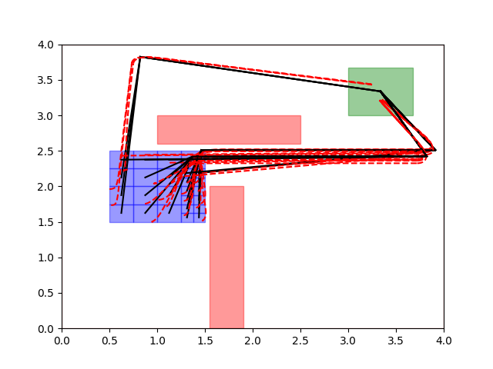
Putting it all together
We showed how to find reference paths using SAT formulation
We showed how to find the error bounds $ℓ_{i}$ using methods from control theory
Putting it all together lets us synthesize controllers that satisfy the reach-avoid specification
Theorem [CAV 20]: overall algorithm iteratively partitions the start set, and it is sound.

Slide 19
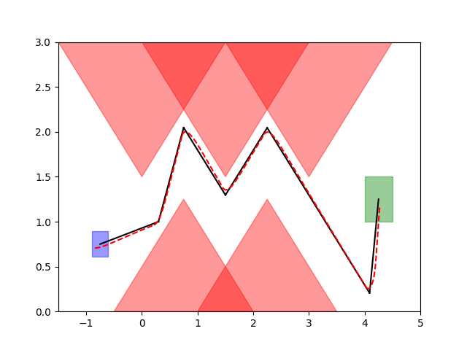
Implementation: FACTEST
Python implementation
yices for synthesizing reference path
website: https://kmmille.github.io/FACTEST/
GitHub: https://github.com/kmmille/FACTEST

Slide 20
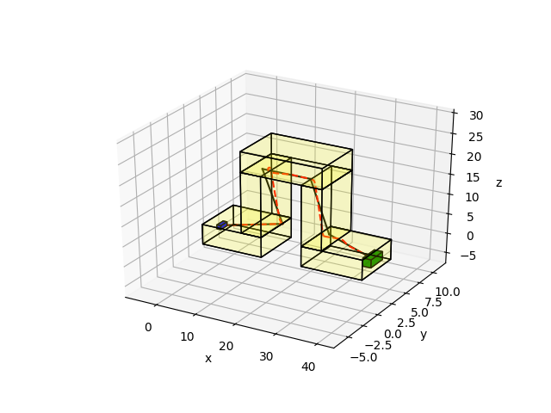
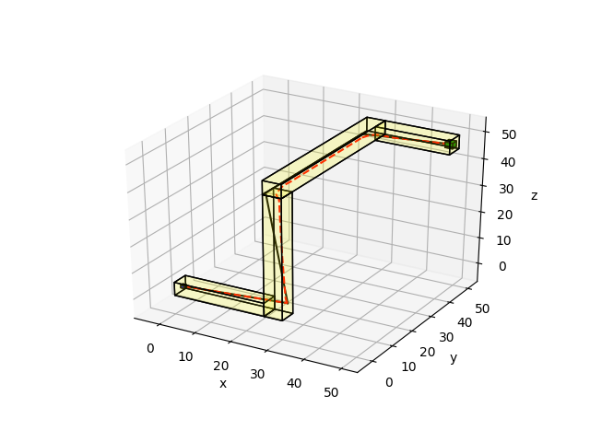
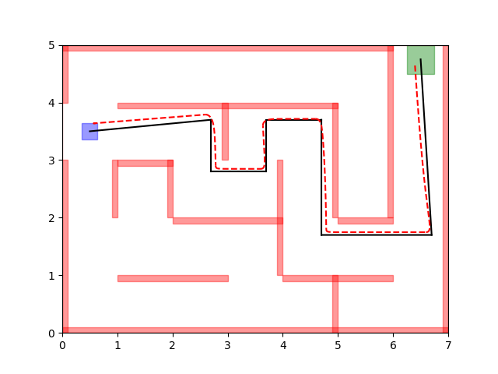
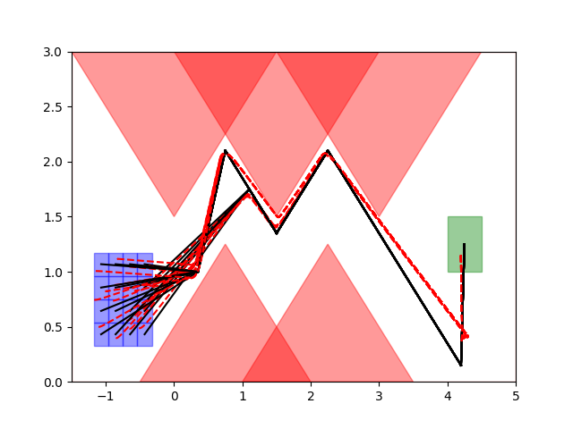
FACTEST effectively synthesizes controllers for various scenarios

Slide 21
FACTEST effectively synthesizes controllers for various scenarios
model | env | S size | state space, input space | num obs | time (s) | num parts
car | zigzag1 | 0.2 | (3, 2) | 9 | 0.027 | 1
car | zigzag2 | 0.4 | (3, 2) | 9 | 0.141 | 4
car | zigzag3 | 0.6 | (3, 2) | 9 | 0.611 | 16
car | maze | 0.2 | (3, 2) | 22 | 0.081 | 1
car | barrier | 0.7 | (3, 2) | 6 | 0.516 | 25
car | SCOTS | 0.08 | (3, 2) | 19 | 0.630 | 1
robot | zigzag1 | 0.2 | (4, 2) | 9 | 0.025 | 1
robot | zigzag2 | 0.4 | (4, 2) | 9 | 0.189 | 4
robot | zigzag3 | 0.6 | (4, 2) | 9 | 0.619 | 16
robot | maze | 0.2 | (4, 2) | 22 | 0.080 | 1
robot | barrier | 0.7 | (4, 2) | 6 | 0.545 | 25
robot | SCOTS | 0.07 | (4, 2) | 19 | 0.643 | 1
auv | ztunnel | 0.9 | (4, 3) | 6 | 0.364 | 1
auv | ltunnel | 0.9 | (4, 3) | 8 | 0.325 | 1
hovercraft | ztunnel | 0.9 | (6, 4) | 6 | 0.4763 | 1
hovercraft | ltunnel | 0.9 | (6, 4) | 8 | 0.1383 | 1

Slide 22
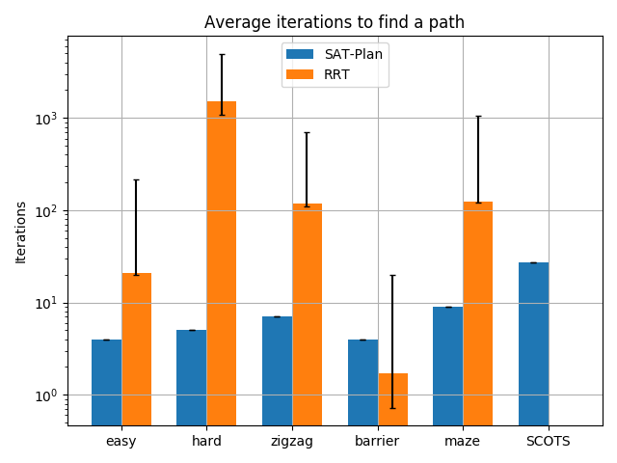
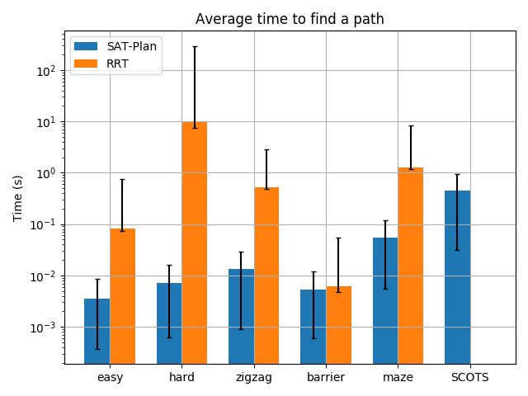
FACTEST vs. RRT
A rapidly exploring random tree (RRT) is one of the most popular algorithm designed to efficiently search nonconvex, high-dimensional spaces by randomly building a space-filling tree.

Slide 23
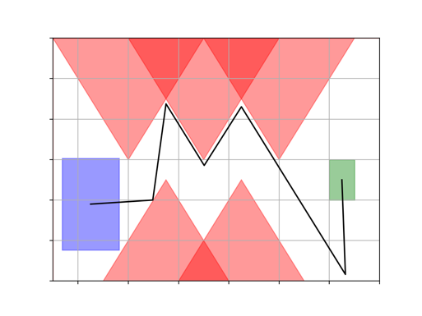
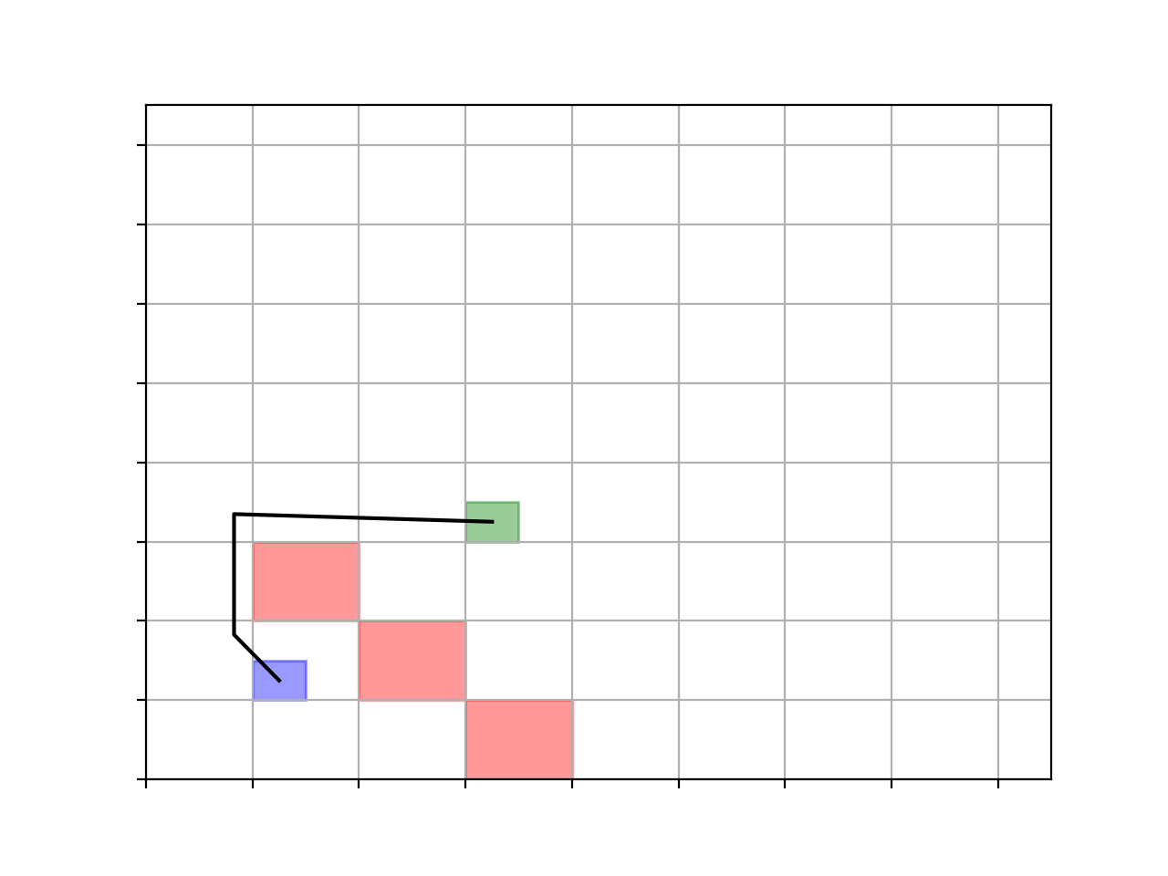
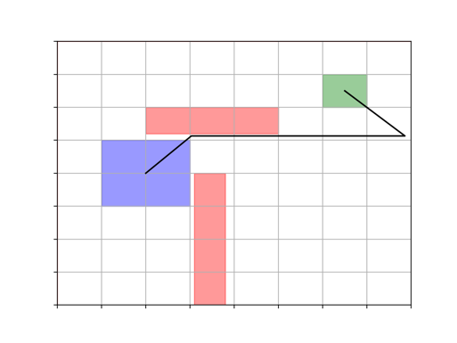
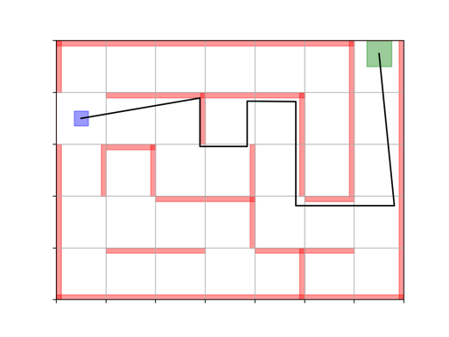
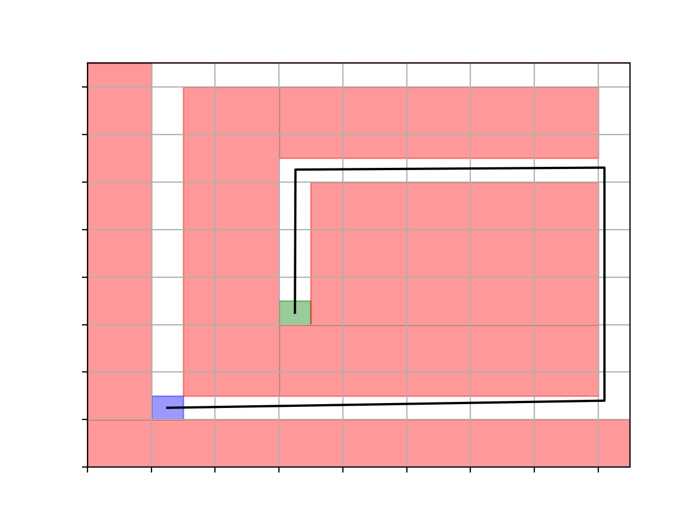
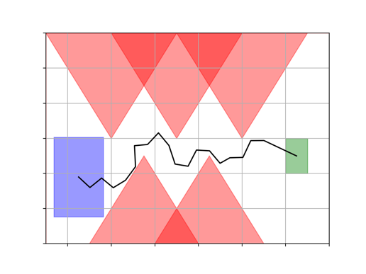
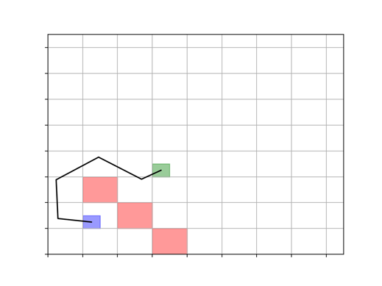
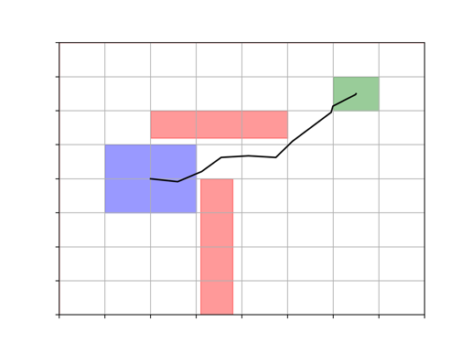
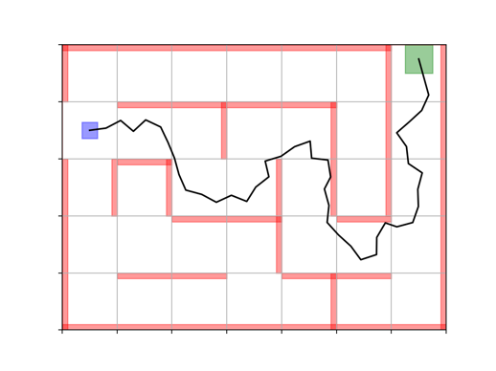
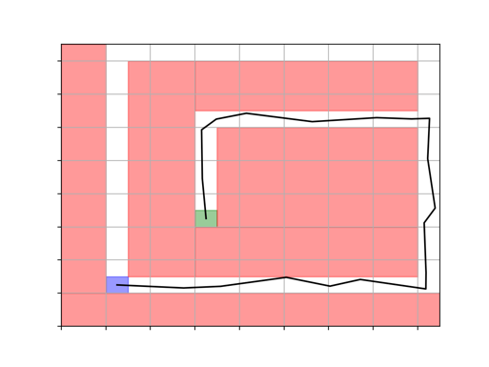
FACTEST vs. RRT
FACTEST Results
RRT Results

Slide 24
Summary and next steps
Open loop controller + tracking controller can serve the reach avoid purpose for dynamical systems
Synthesizing controllers can be efficient
Satisfiability over quantifier-free linear real arithmetic
# constraints is proportional to # surfaces of obstacles and goal
Experiments show scalability
Find controllers in seconds
Ongoing works
Synthesize controllers for dynamic environments
Multi-agent planning

